Slide 1
Street Wise Arts Survey Report
By Bea Halstead

Slide 2
Table of contents
01
02
03
04
05
06
Goals
Audiences
Questions
Alignment to Mission.
Gather data from all.
Recommended surveys.
Methodology
Analysis
Reporting
Implementation.
Options for Analysis.
Finding insights.

Slide 3
01
Goals
Alignment to the Mission

Slide 4
Street Wise Arts Mission
Our mission is to create mural projects, community events, and youth education programs that enhance the urban environment, amplify diversity, and engage people in activism and dialogue.
Quantitative metrics:
# of mural projects, # of community events, # of programs, # of participants, # of web and app visits, # of social media followers and engagement on posts, location of murals, activist themes represented, diversity demographics of artists, organizational staff and volunteers, and participants.
Qualitative metrics:
Moods and feelings around the art and artists. Willingness to support and advocate, advance. Experience at events & programs, individual impact and perspectives on activism themes, and influence on urban aesthetics.

Slide 5
Audience & Surveys
02-03

Slide 6
—Morland 2023, Wild Apricot
“Getting feedback from the attendees, event sponsors, volunteers, and fellow staff allows organizers to get a holistic view of the experience. ”
Notes:
https://www.wildapricot.com/blog/event-survey-questions

Slide 7
Street Wise Mural Festival explores the intersection of Art & Activism while centering womxn, BIPOC, LGBTQIA and emerging artists.

Slide 8
Artist Demographics Survey:
Name
Preferred Name
IG / Social Link
Pronouns*
Location
Sexual Identity*
Ethnicity*
Age Range*
Emerging Artist (< 3 years)
How did you hear about our call to artist?
*always leave sensitive questions optional
The more you can capture initially about the artists, the better
Your data will be when mining for support.
A post-event Survey is a MUST for understanding how they felt about the organization >

Slide 9
Artist Post Event Survey
1
Short and Sweet
Please rate the overall experience (1-5) five being the best experience.
(you can also have categories of these ratings like: Painting, Location, Supplies, Service.
2
Net Promoter Score (NPS)
Would you recommend this event to others? (Yes/No) if no, mind telling us what we can do to improve? (be ready to follow up on these recommendations)
3
Testimonials
Please share a story about your experience, someone you met, or something that impacted you.

Slide 10
Stakeholders
Sponsors
Patrons
BOD, employees, and volunteers
Organization and festival sponsors
individual and in-kind donations and grants

Slide 11
Surveys are tailored to the audience!
Goals
Inputs
Activities
What would each audience care about?
How did their actions contribute?
Were there weaknesses and strengths?
Visibility
Relationships
Insights
Acknowledgement and expectations met?
Did we connect in a meaningful way?
What feedback will impact our outputs?

Slide 12
Festival Attendees
Festival and event attendees are the results of the organization's outputs, and their involvement creates outcomes, which can be measured! YEAH for DATA!

Slide 13
Street Wise Arts Bike Tour

Slide 14
Festival & Event Impacts
01
02
03
Art
Activism
Community
Survey Insights
Public art is accessible in unique ways.
Themes can change values, which change behaviors
Evoke civic pride, and improve public safety and sustainability.
Getting feedback from attendees to capture outcomes involves listing which outcomes each program or event seeks to influence.
Outcomes

Slide 15
Festival Attendee Survey Questions:
Post-Survey
How did you hear about the mural festival?
On a scale of 1-10, how would you rate your overall experience at the festival?
Which mural or artist's work impressed you the most and why?
Did attending the festival change your perspective on any social issues? If so, how?
What additional elements would you like to see in future festivals?
What impact do you think this festival will have on the local community?
How likely are you to engage in activist causes as a result of attending this festival? (1-10 scale)
How accessible did you find the festival (considering factors like location, timing, facilities)?
Would you recommend this festival to others? Why or why not?

Slide 16
04 - Methodology
Type of data
Investing in an online survey provider to aid in reporting insights is key, campaign for $$ for this!
Motives
Thank everyone, incentivize feedback, and build a culture around data with stakeholders and attendees.
Qualitative
Data collection
Prioritize data hygiene for contact information and ask each respondent to share their email and name to build databases. Ask to contact them too.
Specific sampling
Consider the size of the event with the number of responses to gage the margin of error.

Slide 17
05 - Analysis
Descriptive Statistics
Sentiment Analysis
Calculate means, medians, and modes for numerical data to get a general overview of responses.
For open-ended questions, categorize responses as positive, negative, or neutral to see trends.
Thematic Analysis
Impact Assessment
Identify common themes in responses to uncover underlying patterns in feedback.
Review responses to questions about changed perspectives or intentions to measure impact on attitudes and behaviors.

Slide 18
06 - Reporting
Insights Analysis
Funding
Innovation
Invest in Data
Prove impacts
Secure support
Attracts Donors
Theory 1
Feedback can help refine internal and external processes.
Starting with committing to deliver a survey after every event and throughout the festival is a good place to start. Expand to internal stakeholders and sponsors to show you care about advancement.
Theory 2
New ideas and opportunities can come from feedback.
Notes:
Note: I attended both the walking, bike, and Pints for the People event and was never presented with a survey.

Slide 19
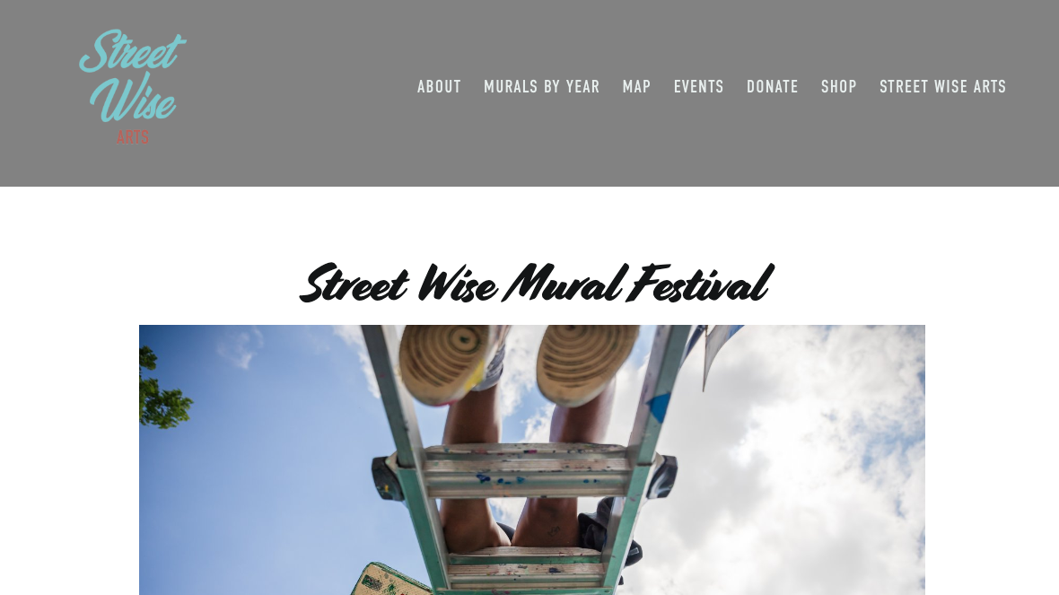
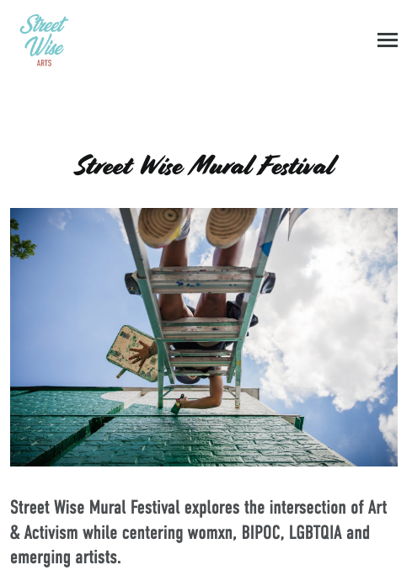
Reminders:
Today, surveys have yet to be shared from the following: walking tour, bike tour, fundraising event at Upslope.
Online and social media experiential data can be combined to augment survey data so share surveys!
Make sure to link to your surveys on your website to track links to forms.
Make sure to remove survey links a week after the event takes place.

Slide 20
Schedule
Task | Description | Date | M | T | W | T | F | S | Status
Task 1 | Review Survey Vendors | 8/6-8/10 |  |  |  |  |  |  | Pending
Task 2 | Build Artist Survey | 8/11-8/15 |  |  |  |  |  |  | Pending
Task 3 | Build Festival Survey | 8/15-8/16 |  |  |  |  |  |  | Pending
Task 4 | Distribute QR codes to volunteers | 9/10-9/12 |  |  |  |  |  |  | Unstarted
Task 5 | Analysis / Report | 9/20 – 9/25 |  |  |  |  |  |  | Unstarted

Slide 21
Resources and References
https://www.surveymonkey.com/mp/post-event-survey-questions/Hand drawn risograph poster template I
https://memberclicks.com/blog/post-event-survey-questions/
https://blog.hubspot.com/marketing/post-event-survey-questions
https://www.qualtrics.com/experience-management/research/post-event-survey-questions/
Hao, Maggie. 2024. “The Integration of Public Art and Social and Cultural Values” Highlights in Art and Design 5, no. 3 (April):4-6. DOI: 10.54097/74dezh34

Slide 22
2024 Mural Activist Theme Analysis

Slide 23
Thanks!
Do you have any questions?
Bea.artmiamor@gmail.com
954.770.1129
Artmiamor.com (under construction)
*Photo credits: Allyson, featured on a walking tour and Leah for the photo of myself and my friend on the bike tour.
Please keep this slide for attribution

